Slide 1

Welcome!

Slide 2
Housekeeping
Wi-fi Information:
  Wireless Network: Lesley_Open
  Username: TLI_WIFI
  Password: JH$Qa1
Use hashtag #RightCare on Twitter

Slide 3
Who’s Here?

Slide 4
Vikas’ Slides here

Slide 5
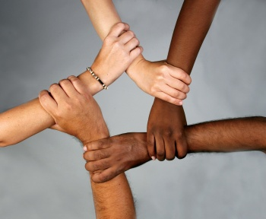

Introduction to Organizing

Slide 6
Who is here?
Notes:
Steph

Slide 7
Agenda Review
Norms
Introductions + Roles
Notes:
Steph – Agenda Review
Pedja – norms
Steph – intros and roles

Slide 8
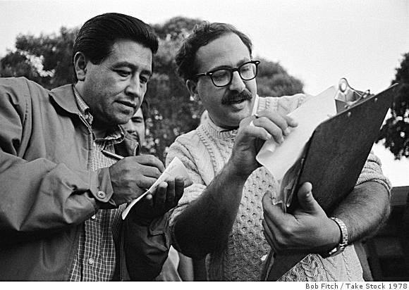
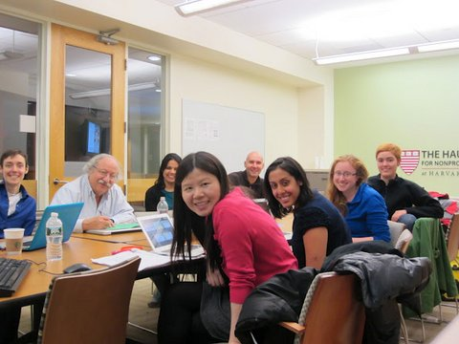
ACKNOWLEDGMENTS
Originally adapted from the work of Marshall Ganz, Harvard University. Modified by the Leading Change Network, New Organizing Institute and with the help of many dedicated partners.
Notes:
Steph

Slide 9

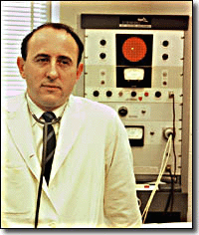

Background and ancestor movements
Notes:
Steph

Slide 10
MEET PEDJA
Notes:
Pedja

Slide 11
How do we make change?
Notes:
Steph

Slide 12

Theory of Change
Informational (Lown)
Awareness
Social Media
Technical
Legal/Policy
Hollywood
Educational
People-Power
Notes:
Steph

Slide 13

Theory of Change
Informational (Lown)
Awareness
Social Media
Technical
Legal/Policy
Hollywood
Educational
People-Power
Notes:
Pedja

Slide 14

Theory of Change
Informational
Awareness
Social Media
Technical
Legal/Policy
Hollywood
Educational
People-Power
Notes:
Steph

Slide 15

Theory of Change
Informational
Awareness
Social Media
Technical (there’s an app for that)
Legal/Policy
Hollywood
Educational
People-Power
Notes:
Pedja

Slide 16
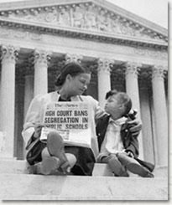
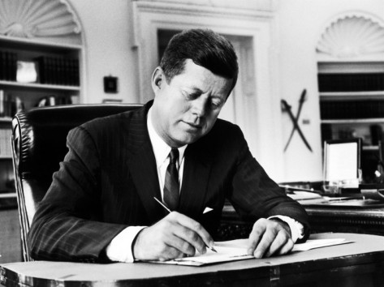
Theory of Change
Informational
Awareness
Social Media
Technical
Legal/Policy – (elect candidates, pass bills, win court cases) – sometimes we use this strategy, but take an organizing approach to get there
Hollywood
Educational
People-Power
Notes:
Steph

Slide 17

Theory of Change
Informational
Awareness
Social Media
Technical (there’s an app for that)
Legal/Policy
Hollywood (make our message popular)
Educational
People-Power
Notes:
Pedja

Slide 18
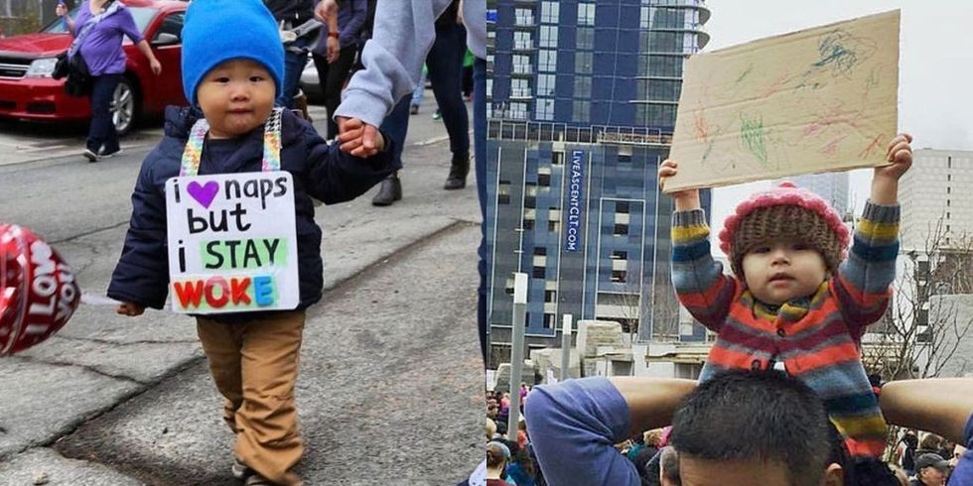
Theory of Change
Informational
Awareness
Social Media
Technical (there’s an app for that)
Legal/Policy
Hollywood
Educational (if we teach ’em when they’re young)
People-Power
Notes:
Steph

Slide 19
Why Organizing?
Theory of Change
Informational
Awareness
Social Media
Technical (there’s an app for that)
Legal/Policy
Hollywood
Educational (if we teach ’em when they’re young)
People-Power
Notes:
Pedja

Slide 20
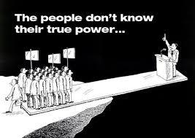
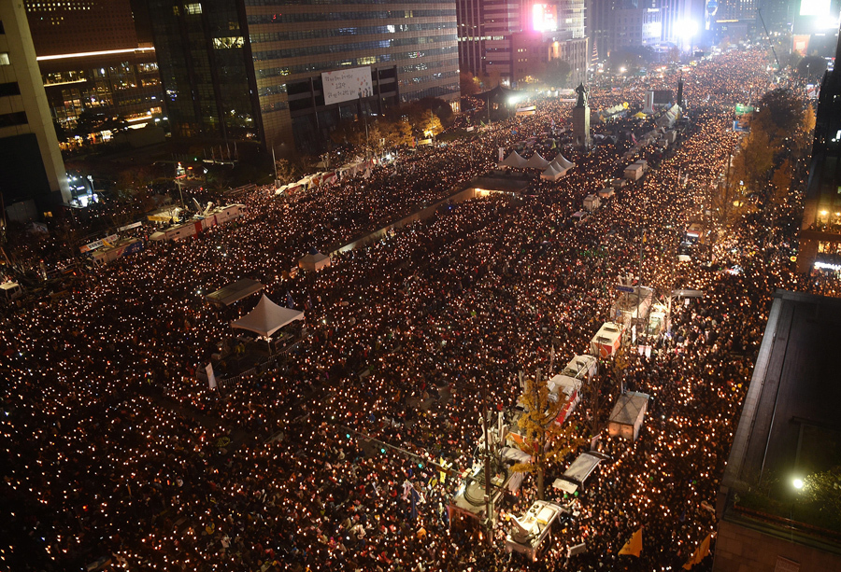
South Korea, Nov. 2016
Notes:
Pedja

Slide 21
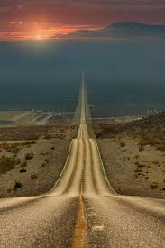

Notes:
Steph

Slide 22

Organizers Ask:
PEOPLE: who are my people?
CHANGE: what is their problem/goal?
POWER: how can they turn their resources into the power they need to achieve the change they want?
Notes:
Pedja

Slide 23

What is leadership?
Taking responsibility
for enabling others
to achieve shared purpose
in the face of uncertainty.
Notes:
Steph

Slide 24
DISORGANIZATION |  | ORGANIZATION
PASSIVE |  | ACTIVE
DIVIDED |  | UNITED
DRIFT |  | PURPOSE
REACTIVE |  | INITIATIVE
INACTION |  | CHANGE
Notes:
Pedja

Slide 25
DISORGANIZATION | LEADERSHIP | ORGANIZATION
PASSIVE | SHARED STORY | ACTIVE
DIVIDED | RELATIONAL COMMITMENT | UNITED
DRIFT | CLEAR STRUCTURE | PURPOSE
REACTIVE | CREATIVE STRATEGY | INITIATIVE
INACTION | EFFECTIVE ACTION | CHANGE
Notes:
Pedja

Slide 26
5 Practices
1. Story
2. Relationships
3. Teams
4. Strategy
5. Action
Notes:
Steph

Slide 27
Organizing Tradition
Organizers step up…
CHANGE
PROBLEM
Opposition: Status Quo
BUILD
Constituency
POWER
RESOURCES
Notes:
Pedja

Slide 28
ORGANIZATION CYCLE
CAMPAIGN CYCLE
Notes:
Steph

Slide 29
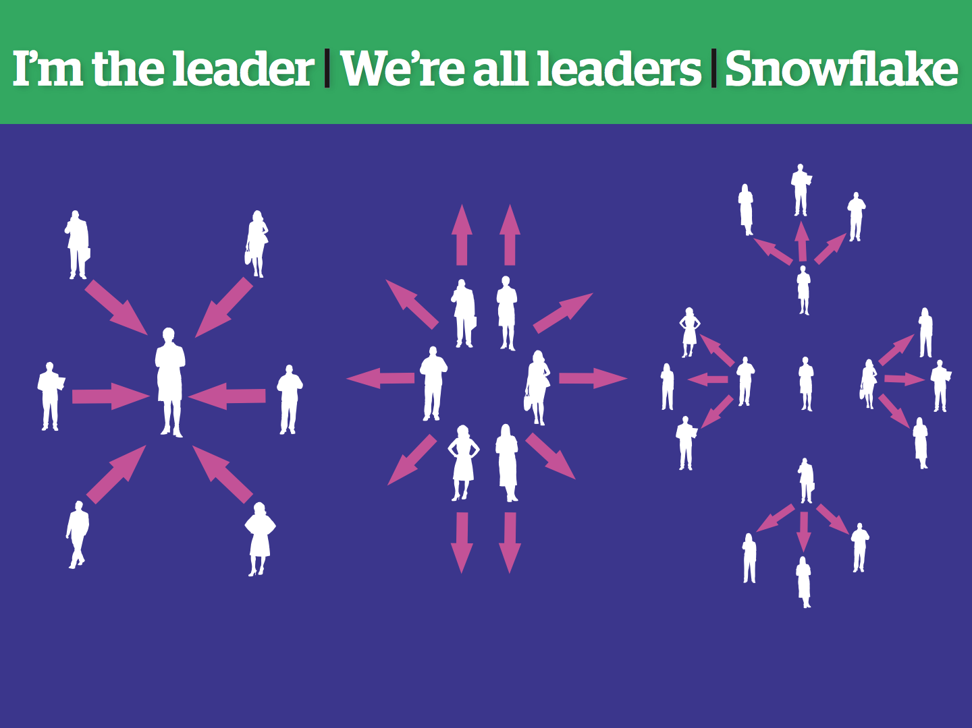
Notes:
Pedja
Now that we know teams can be great…how do we make effective ones?

Slide 30
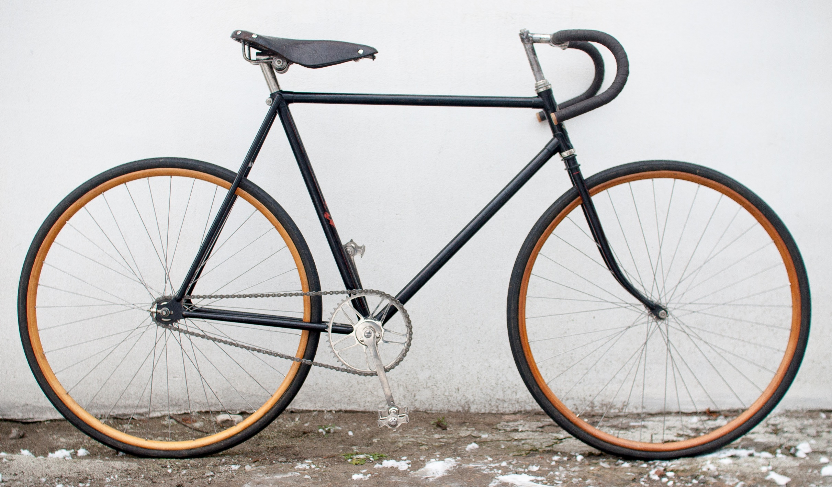

Slide 31
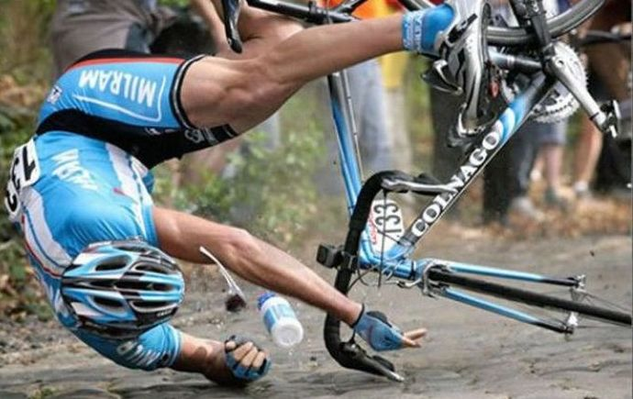
Notes:
Steph

Slide 32

Break!

Slide 33
Introduction to Public Narrative and Story of Self

Slide 34
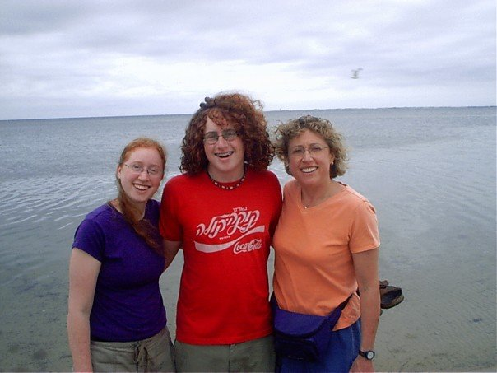
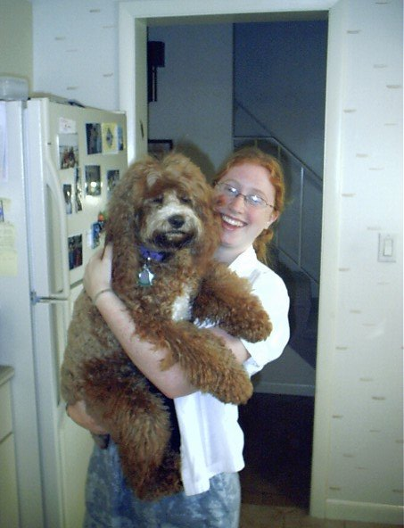
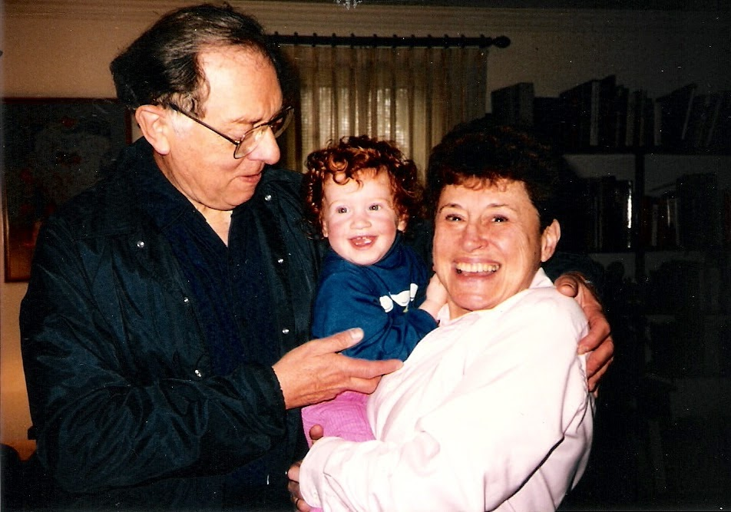
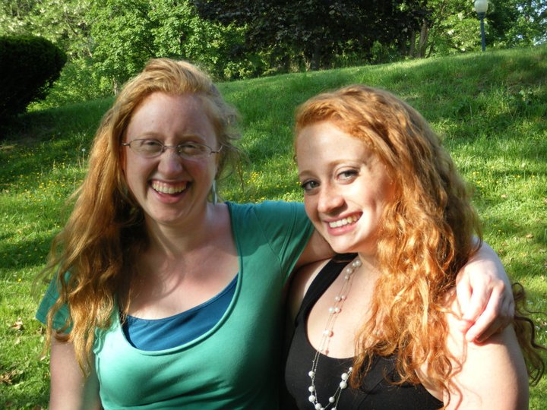
Steph’s Story

Slide 35
What is Leadership?
Taking responsibility
for enabling others
to achieve shared purpose
in the face of uncertainty.
Notes:
Fix title of what is leadership

Slide 36




WHY
HOW
Strategy
Analysis
Story
Motivation
Mindful Action

Slide 37






AGENCY: THE EMOTIONAL CAPACITY TO MAKE MINDFUL CHOICES
URGENCY
Inertia
ANGER
Apathy
AGENCY MOTIVATORS
AGENCY INHIBITORS
Fear
HOPE
Isolation
SOLIDARITY
Self Doubt
YCMD

Slide 38

EMOTIONS
EMOTIONS
EMOTIONS
VALUES
ACTION

Slide 39


CHALLENGE
OUTCOME
MORAL/VALUES
CHOICE
PLOT

Slide 40
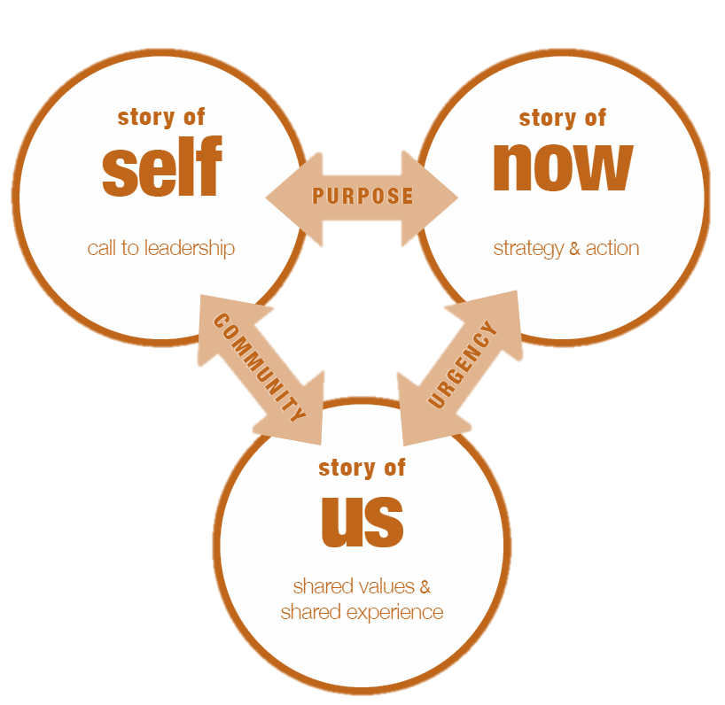
Public Narrative

Slide 41
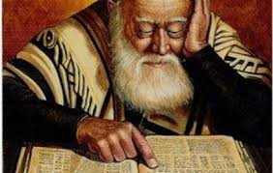
Story of Self
Why am I called to leadership?
If I am not for myself, who will be for me?
-Rabbi Hillel

Slide 42

Story of Us
Why are we called to leadership?
If I am for myself alone, what am I?
-Rabbi Hillel

Slide 43
Story of Now
Call to Action: Why must we act together right now? What do we do?
If not now, when?
-Rabbi Hillel

Slide 44
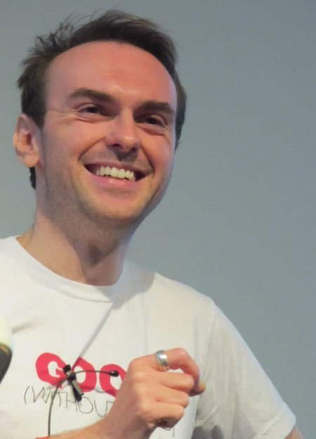
Model of Public Narrative: James Croft
When do you hear a Story of Self, Us, and Now?
What challenge, choice, and outcome are at the core of each story he tells?
What details, images, moments bring these stories alive?

Slide 45
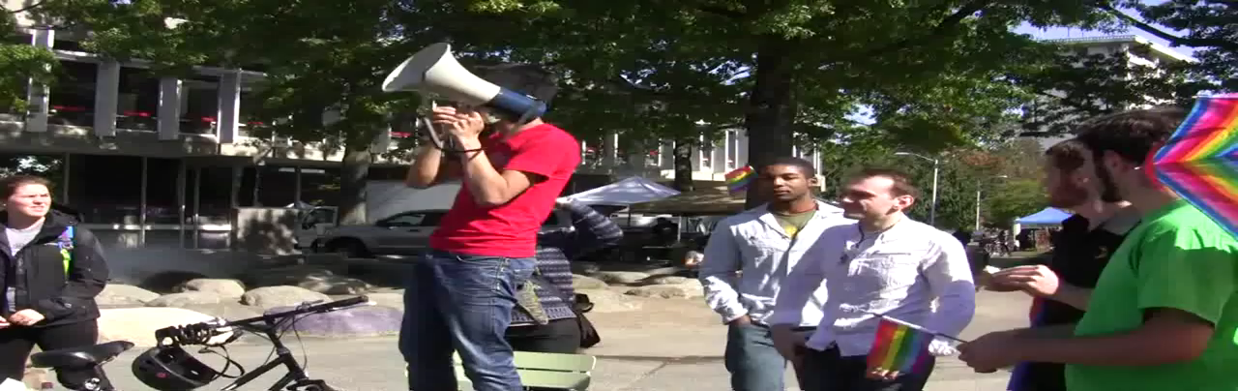

Slide 46
Story of Self

Slide 47
CHALLENGE
OUTCOME
CHOICE
MORAL
PLOT

Slide 48
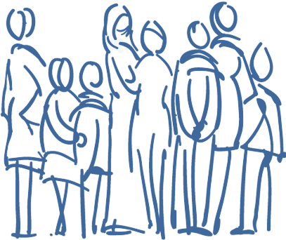
What calls you to leadership with the Right Care Alliance?

Slide 49
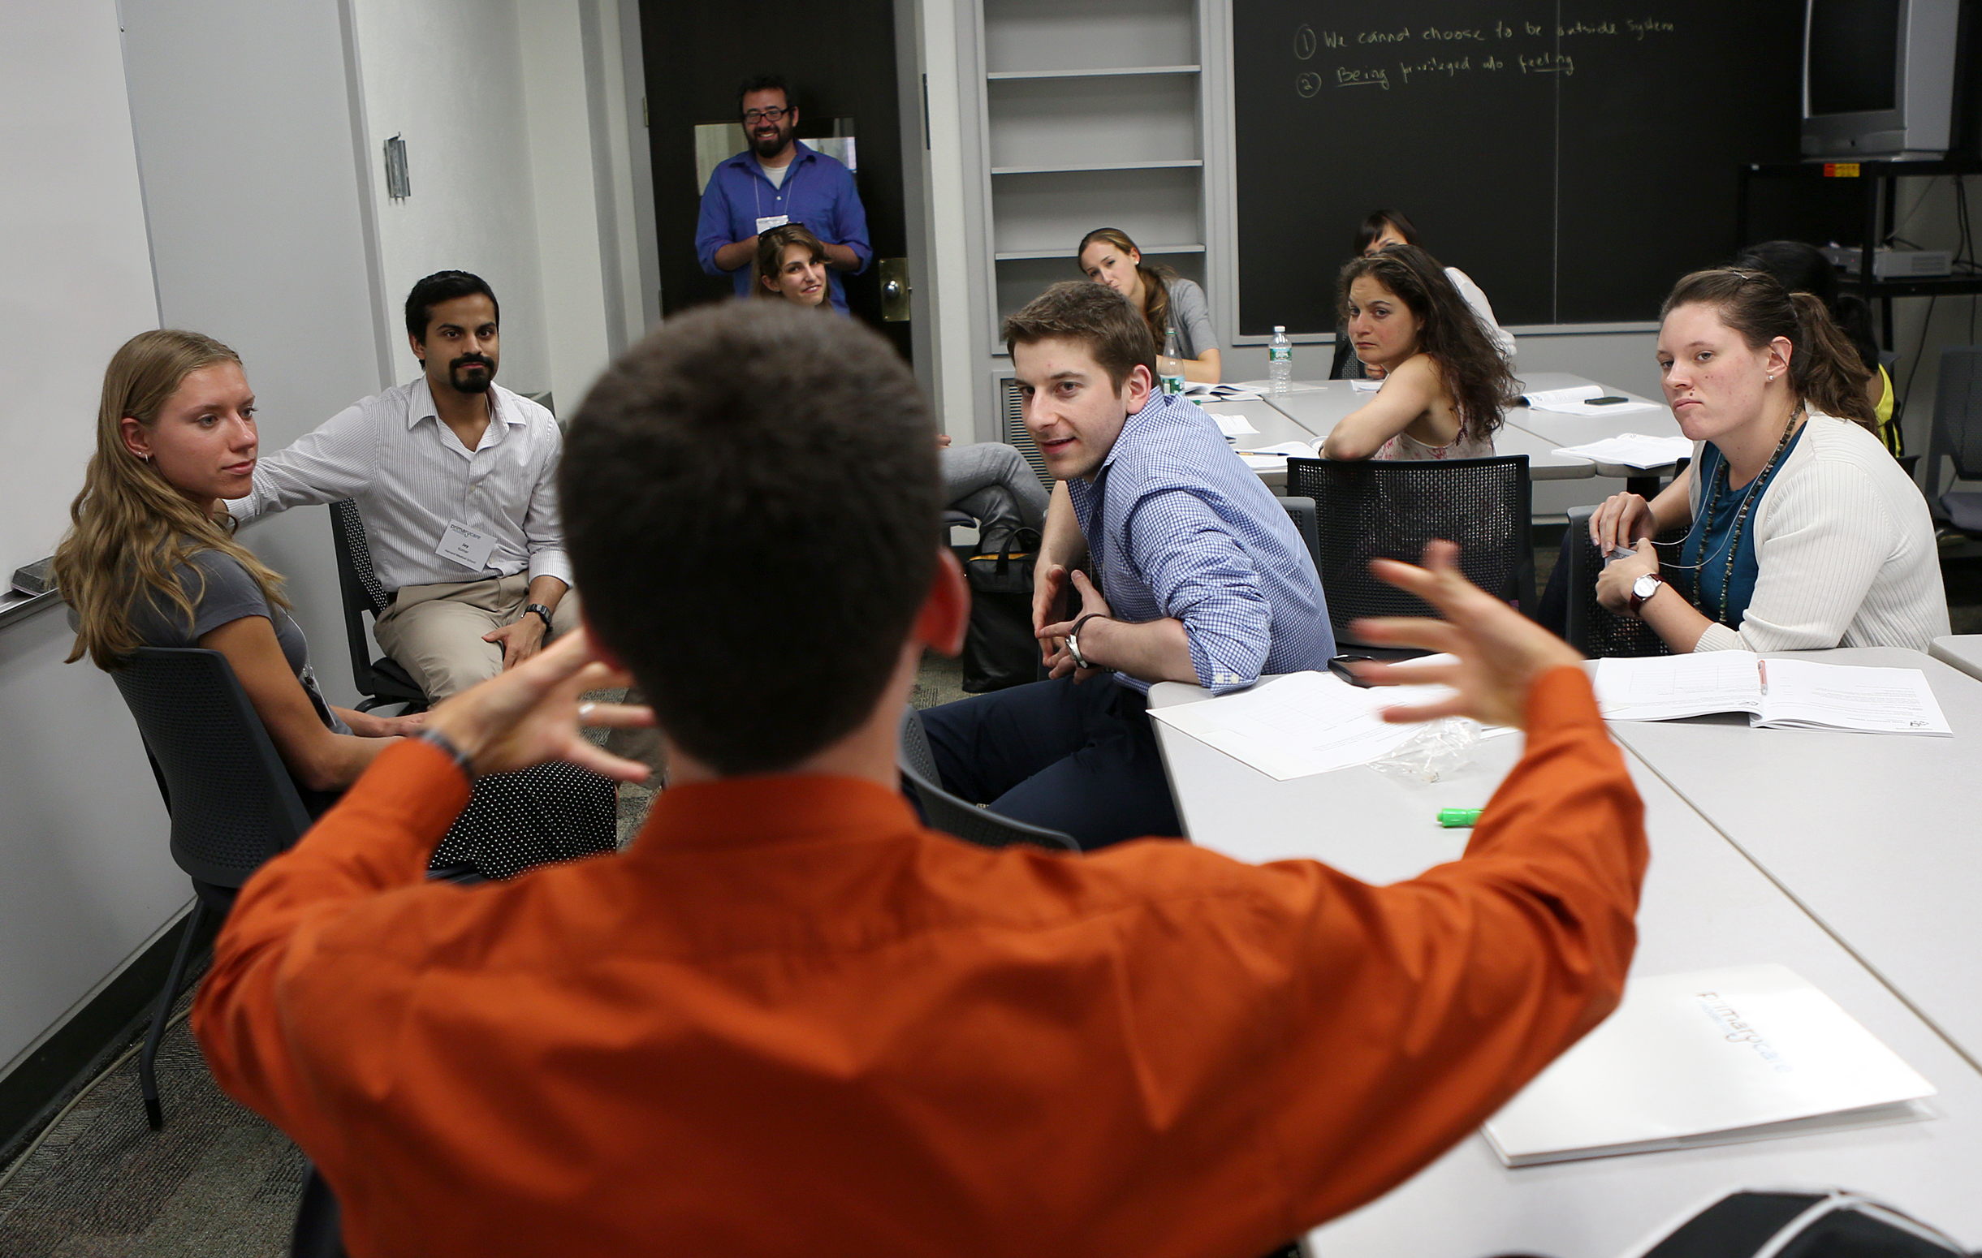
Example and Debrief

Slide 50
What calls you to leadership with the Right Care Alliance?

Slide 51
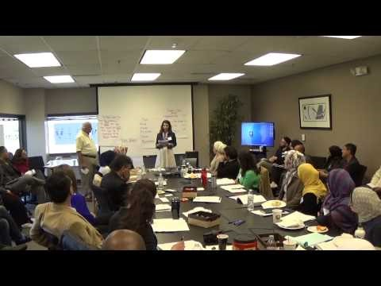

Slide 52
Story of Self: Pitfalls to Avoid
DO:
DON’T:
Share experiences.
Pick 1-2 choice points that relate to your calling to be here today.
Tell a personal story, in which YOU are the main character.
Be specific, vivid, clear…see it, hear it, feel it.
Share what gives you HOPE!
Give your resume.
Tell your whole life story from birth to now.
Tell a story about the issues only.
Be abstract.
Make it all about the nightmare.

Slide 53
TEAMWORK*
*MAKES THE DREAM WORK
Review the goals, agenda and norms.
Facilitator shares 2-minute story of self.
Silently develop story using the worksheet.
Share your 2-minute story and receive 3-minutes of coaching.
    Question: What are the experiences in your life call you to leadership with the Right Care Alliance?
Return to large group for debrief.

Slide 54

DEBRIEF*
*Key Learnings

